Slide 1
More CSS
Dr. MJ Uddin

Slide 2
CSS tables

Slide 3
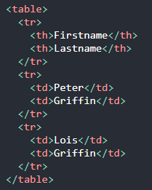


CSS tables
The look of an HTML table can be greatly improved with CSS.

Slide 4

CSS tables
The table above might seem small in some cases. If you need a table that should span the entire screen (full-width), add width: 100% to the <table> element.
Notice that the table in the examples above have double borders. This is because both the table and the <th> and <td> elements have separate borders. To remove double borders, take a look at the example below.
The border-collapse property sets whether the table borders should be collapsed into a single border:

Slide 5
CSS tables
The width and height of a table are defined by the width and height properties.
For example, to create a table that should only span half the page, use width: 50%
You can use text-align to set the horizontal alignment of the contents inside the table cell boxes.

Slide 6
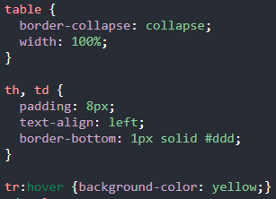
CSS tables
Use the :hover selector on <tr> to highlight table rows on mouse over:

Slide 7
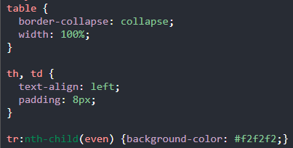
CSS tables
For zebra-striped tables, use the nth-child() selector and add a background-color to all even (or odd) table rows:

Slide 8
CSS pseudo-classes

Slide 9
CSS pseudo classes
:hover and :nth-child are examples of pseudo classes.
A pseudo-class is used to define a special state of an element.
For example, it can be used to:
Style an element when a user mouses over it
Style visited and unvisited links differently
Style an element when it gets focus

Slide 10

CSS pseudo classes
The syntax of pseudo-classes:
Perhaps the best example is of anchor pseudo classes as shown next -

Slide 11
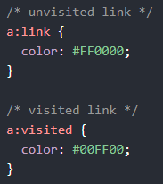
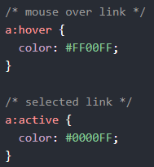
CSS pseudo classes
Examples -

Slide 12
CSS pseudo classes
a:hover MUST come after a:link and a:visited in the CSS definition in order to be effective!
a:active MUST come after a:hover in the CSS definition in order to be effective!
Can you explain why?
Pseudo-class names are not case-sensitive.

Slide 13

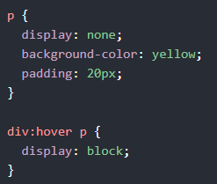
CSS pseudo classes
Example - using the :hover pseudo-class on a <div> element:
Hover over a <div> element to show a <p> element (like a tooltip):

Slide 14
Other pseudo-classes
pseudo-class | Type | Functionality
:autofill | input | Matches when an <input> has been autofilled by the browser.
:enabled/:disabled | input | Represents a user interface element that is in an enabled/disabled state.
:read-write | input | Represents any element that is user-editable.
:link | location | Matches links that have not yet been visited.
:target | location | Matches the element which is the target of the document URL.
:paused/playing | resource state | Represents a media element that is capable of playing when that element is paused/playing.
:empty | tree-structural | Represents an element with no children other than white-space characters.
:hover/:active | user action | Matches when a user designates an item with a pointing device and :active matches when an item is being activated by the user.

Slide 15
CSS gradients

Slide 16


CSS gradients
Syntax -
background-image: linear-gradient(direction, color-stop1, color-stop2);
Examples

Slide 17

CSS gradients
Examples

Slide 18
CSS shadows

Slide 19



CSS shadows
The CSS text-shadow property applies shadow to text. In its simplest use, you only specify the horizontal shadow (2px) and the vertical shadow (2px):
Next, add a color to the shadow: text-shadow: 2px 2px red;

Slide 20




CSS shadows
Then, add a blur effect to the shadow:
The following example shows a red neon glow shadow:

Slide 21


CSS shadows
To add more than one shadow to the text, you can add a comma-separated list of shadows. The following example shows a red and blue neon glow shadow:

Slide 22

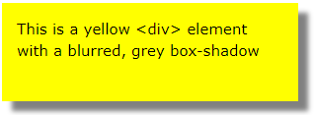

CSS shadows
The CSS box-shadow property applies shadow to elements. In its simplest use, you only specify the horizontal shadow and the vertical shadow:
Next, add blur and color just like you would with text shadow

Slide 23
Let’s review everything again!

Slide 24
Review
CSS has many helpful sources of information online. It is impossible to be good at CSS without ever having to use them.
As previously mentioned, my favourite of them is w3schools.
Let’s gather what we have learnt so far, and try the exercises on w3schools.
Before you begin, give a thorough revision of the concepts taught earlier.

Slide 25
Review
For best results, try to solve the exercises without any help from the internet. Then you can retry the missed exercises with the help of the internet this time.
Like every tech project in life, you are likely to find problems that you haven’t seen before. You can’t avoid this. So it's best to learn to deal with it.

Slide 26
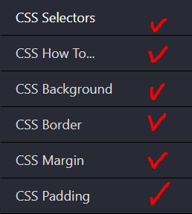
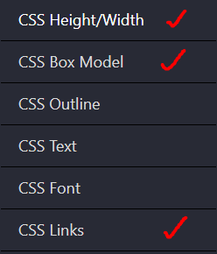
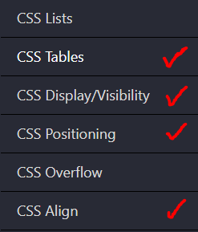
Review
Enough talk! Head over to this website. Solve questions from the following sections -

Slide 27
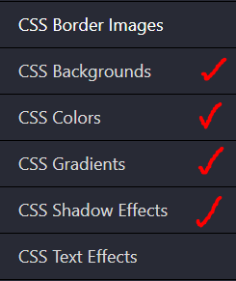
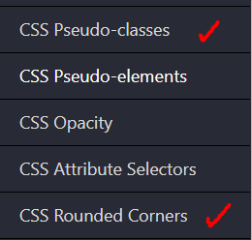
Review
(continued) -

